Slide 1
Positioning Elements
The Position Property | Fixed Positioning | Absolute Positioning | Z-index Property
Notes:
Welcome to our lecture on CSS positioning elements. In this lecture we will go through positioning property, fixed positioning, absolte positioning, and z-index property. Let’s start our lecture.

Slide 2
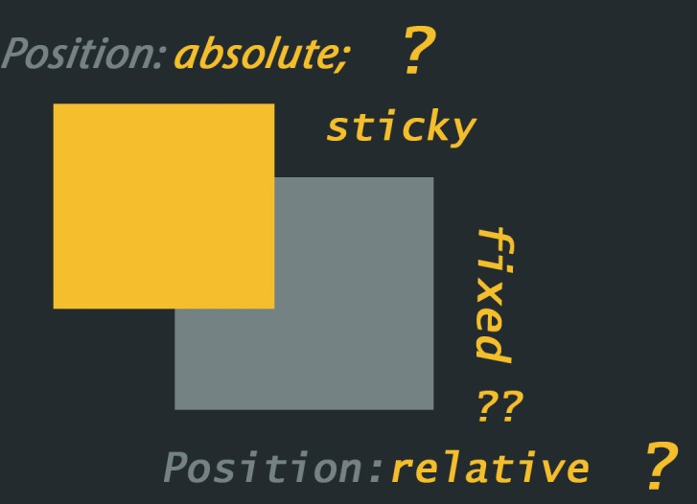
The Position Property
position property: Controls element placement in the browser, offering more flexibility.
static: Default positioning with no special placement.
relative: Positions the element relative to its default position.
fixed: Positions the element relative to the viewport, staying fixed even when scrolling.
absolute: Positions the element relative to the nearest positioned ancestor.
Notes:
The position property in CSS defines how an element is placed in the browser. Static is the default with no special placement. Relative positions the element based on its normal position. Fixed positions the element relative to the viewport, unaffected by scrolling. Absolute positions the element relative to its nearest positioned ancestor, allowing for precise layouts.

Slide 3
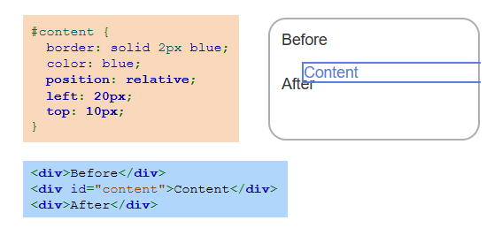
Example
Notes:
This example demonstrates relative positioning in CSS. The content div is styled with position relative, allowing it to be shifted from its normal flow using left 20px and top 10px. The border and color properties are added for visual clarity. Despite its new position, the element remains part of the document flow, so the Before and After elements are not affected.

Slide 4
Fixed Positioning
Fixed positioning: Places the element at a fixed location in the viewport, unaffected by scrolling.
Viewport: The visible area of the webpage where the fixed element remains stationary.
Layering: The fixed element is detached from the normal flow and appears above other page content.
Notes:
The first type of position property is fixed positioning that places an element at a specific location in the viewport, keeping it stationary even when the page scrolls. The viewport is the visible area of the webpage where the fixed element remains in place. A fixed element is detached from the normal flow of the document and is layered above other content, making it ideal for elements like headers or navigation menus.

Slide 5
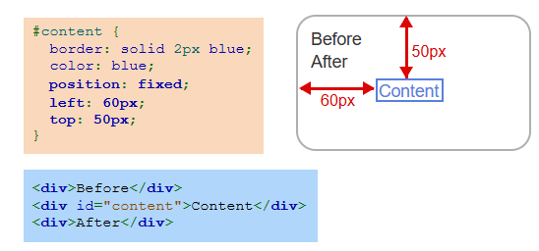
Example
Notes:
This example demonstrates fixed positioning. The content div is styled with position fixed, placing it 60px from the left and 50px from the top of the viewport. The element remains stationary when scrolling, detached from the normal document flow. Other elements, like Before and After, are unaffected by its position, and the fixed element is layered above them for emphasis.

Slide 6
Absolute Positioning
Absolute positioning: Positions the element relative to the nearest positioned ancestor (fixed, absolute, or relative).
Fallback: If no positioned ancestor exists, the element is positioned relative to the document body.
Scrolling behavior: The element scrolls with the document unless an ancestor has fixed positioning.
Notes:
The second type of position property is absolute positioning that places an element relative to the nearest positioned ancestor that uses fixed, absolute, or relative positioning. If no such ancestor exists, the element defaults to positioning relative to the document body. Unlike fixed positioning, the element scrolls with the document unless an ancestor has fixed positioning, making it flexible for layered designs.

Slide 7
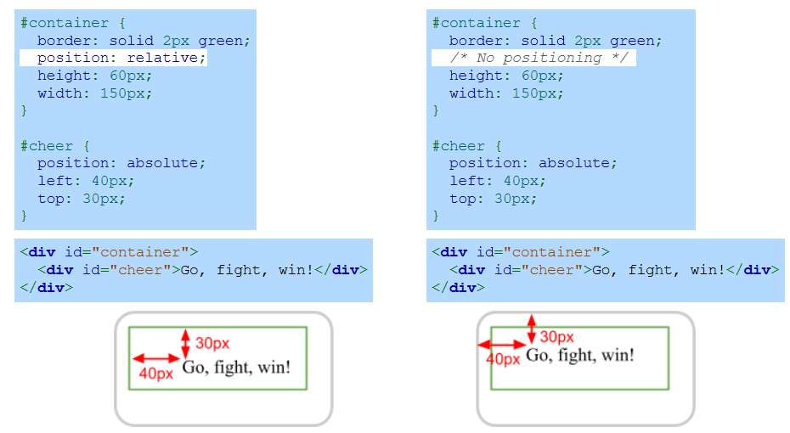
Example
Notes:
This example illustrates absolute positioning. In the first case, the container has relative positioning, so the cheer element is positioned 40px left and 30px top relative to the container. In the second case, without container positioning, the cheer element is positioned relative to the document body. Absolute positioning depends on the nearest positioned ancestor, offering precise control.

Slide 8
Z-Index Property
Default stacking order: Positioned elements appear in the order they are listed in the HTML, with the last element rendered on top.
z-index property: Specifies the stacking order of elements; higher z-index values place elements above lower z-index ones.
Example: Without z-index, the green square appears on top; with z-index, the orange square (higher value) is rendered above the green square.
Notes:
Now we will discuss z-index property that controls the stacking order of elements. By default, elements appear in the order they are listed in the HTML, with the last one rendered on top. The z-index property allows customization, where elements with higher z-index values appear above those with lower values. For example, setting a higher z-index on the orange square places it above the green square in the stack.

Slide 9
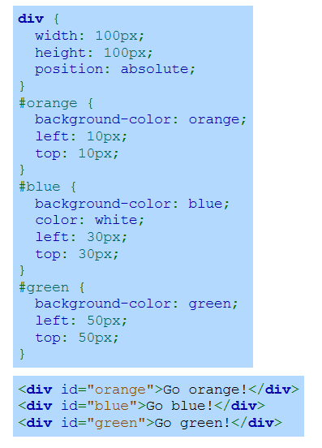
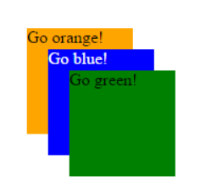
Example Without Index
Notes:
This example demonstrates three absolutely positioned div elements without using z-index. Each div is given a background color orange, blue, green and positioned at different coordinates. The default stacking order places the orange div on top of the blue one, and the blue div on top of the green one, as determined by their order in the HTML. The divs overlap based on their positioning.

Slide 10
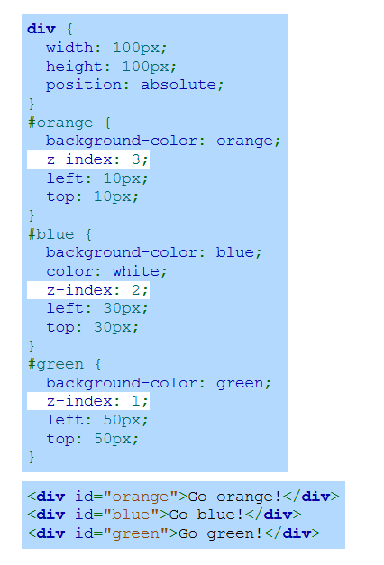
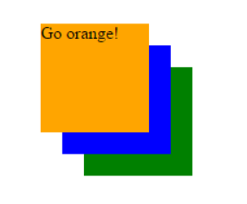
Example With Z-Index
Notes:
This example demonstrates using the z-index property to control the stacking order of absolutely positioned elements. The orange div has z-index 3, placing it on top. The blue div with z-index 2 appears below the orange but above the green. The green div has z-index 1, making it the bottom layer. Z-index ensures precise control over overlapping elements regardless of their order in the HTML. Thanks for watching the lecture.

